Slide 1
Lecture 6
File Systems

Slide 2
File Systems
Many important applications need to store more information than what they have in the address space of a process such as airline reservations, banking, or corporate record keeping. A second problem with keeping information within a process’ address space is that when the process terminates, the information is lost. A third problem is that it is frequently necessary for multiple processes to access (parts of) the information at the same time. If we have an online telephone directory stored inside the address space of a single process, only that process can access it.
We have three essential requirements for long-term information storage:
1. It must be possible to store a very large amount of information.
2. The information must survive the termination of the process using it.
3. Multiple processes must be able to access the information at once.

Slide 3
File Systems
Disks are used to store files
Information is stored in blocks on the disks
Has to support two operations:
1. Read block k.
2. Write block k
Just a few of the questions that quickly arise are:
1. How do you find information?
2. How do you keep one user from reading another user’s data?
3. How do you know which blocks are free?

Slide 4
File Systems
A file is an abstraction mechanism. It provides a way to store information on the disk and read it back later. This must be done in such a way as to shield the user from the details of how and where the information is stored, and how the disks actually work.
Files are created by a process
A disk will usually contain thousands or even millions of them, each one independent of the others.
Managed by the OS.
As a whole, that part of the operating system dealing with files is known as the file system
Tanenbaum, Modern Operating Systems 3 e, (c) 2008 Prentice-Hall, Inc. All rights reserved. 0-13-6006639

Slide 5
File Systems
OS structures them, names them, protects them
Two ways of looking at file system
  User: how do we name a file, protect it, organize the files
  Implementation: how are they organized on a disk
Tanenbaum, Modern Operating Systems 3 e, (c) 2008 Prentice-Hall, Inc. All rights reserved. 0-13-6006639

Slide 6
File Systems
The user point of view
  Naming
  Structure
  Directories
Tanenbaum, Modern Operating Systems 3 e, (c) 2008 Prentice-Hall, Inc. All rights reserved. 0-13-6006639

Slide 7
Naming
  All current operating systems allow strings of one to eight letters as legal file names. Frequently digits and special characters are also permitted. Many file systems support names as long as 255 characters.
  Latest Window systems use NTFS (NT file system and the New Technology File System)
  Many operating systems support two-part file names, with the two parts separated by a period, as in prog.c.
  The part following the period is called the file extension and usually indicates something about the file.
  In MS-DOS, for example, file names are 1 to 8 characters, plus an optional extension of 1 to 3 characters.
  In UNIX, the size of the extension, if any, is up to the user, and a file may even have two or more extensions, as in homepage.html.zip, where .html indicates a Web page in HTML and .zip indicates that the file (homepage.html) has been compressed using the zip program.
  UNIX file extensions are just conventions and are not enforced by the operating system.
  In contrast, Windows is aware of the extensions and assigns meaning to them.

Slide 8
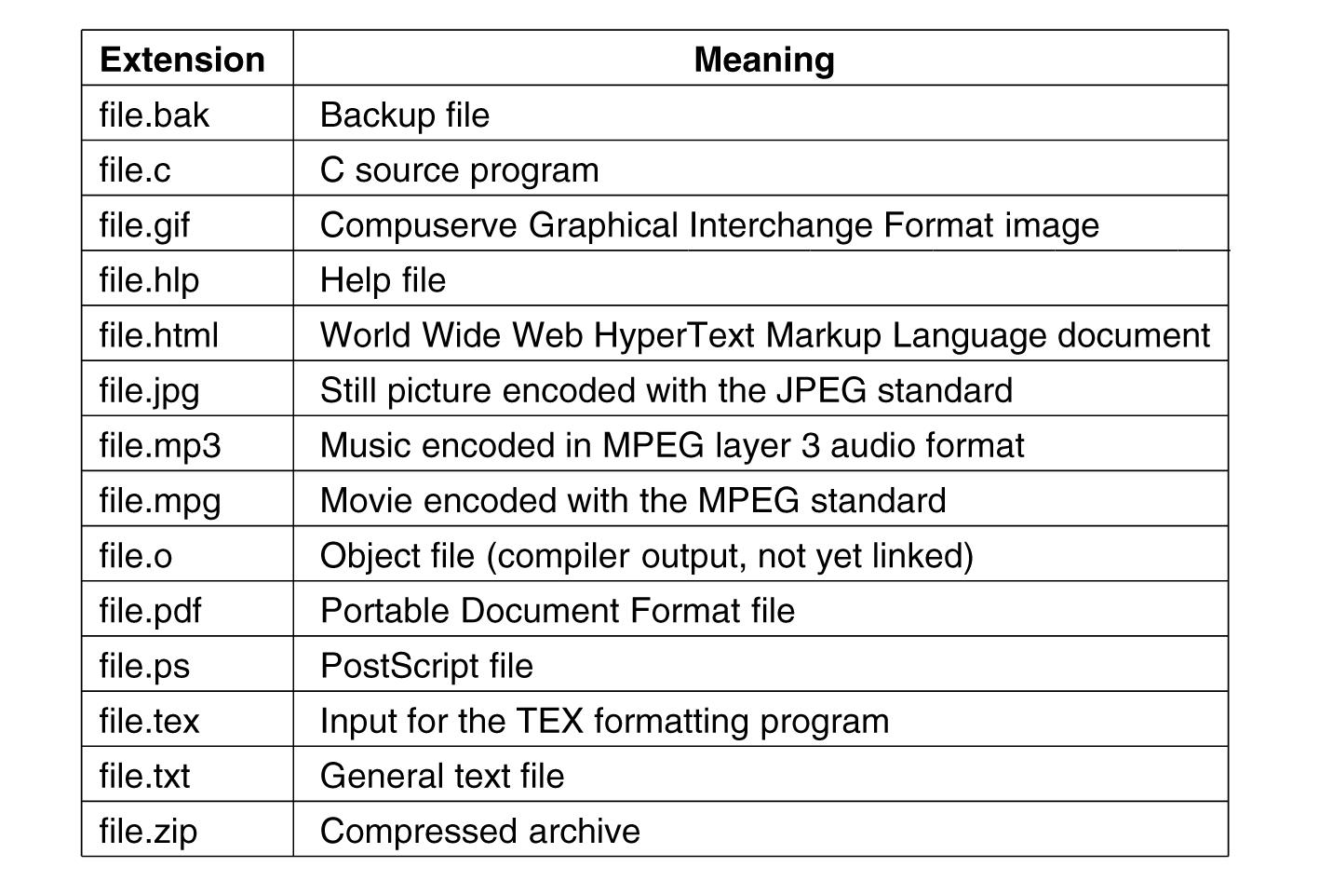
Some Typical File Extensions
.
Tanenbaum, Modern Operating Systems 3 e, (c) 2008 Prentice-Hall, Inc. All rights reserved. 0-13-6006639

Slide 9
File Structure
  Byte sequences
    Having the operating system regard files as nothing more than byte sequences provides the maximum amount of flexibility.
    Unix and Windows use this approach
  Fixed length records: each with some internal structure.
  Tree of records: not necessarily all the same length, each containing a key field in a fixed position in the record. The tree is sorted on the key field, to allow rapid searching for a particular key. For the zoo file of the Figure one could ask the system to get the record whose key is pony, for example. New records can be added to the file, with the operating system, and not the user, deciding where to place them. Used on some large mainframe computers for commercial data processing.

Slide 10
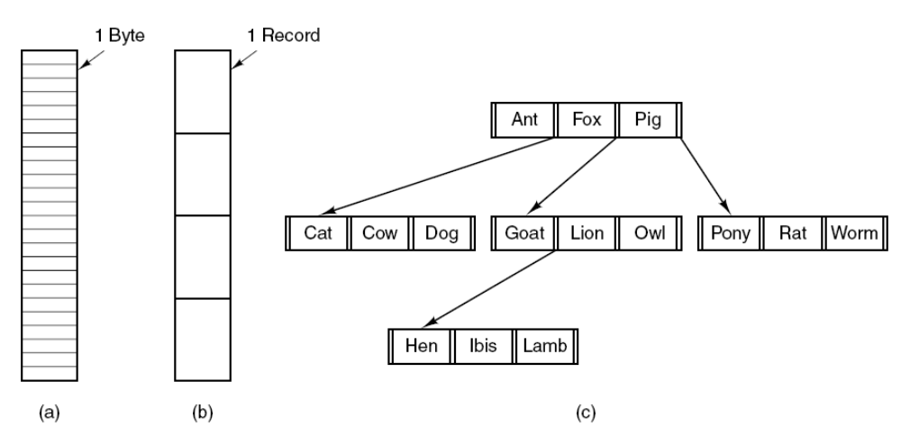
File Structure
Three kinds of files. (a) Byte sequence.
(b) Record sequence. (c) Tree.
Tanenbaum, Modern Operating Systems 3 e, (c) 2008 Prentice-Hall, Inc. All rights reserved. 0-13-6006639

Slide 11
File Types
Regular: contains user information
Directories: system files for maintaining the structure of the file system.
Character special files: used to model serial I/O devices (e.g. printers)
Block special files: used to model disks
Tanenbaum, Modern Operating Systems 3 e, (c) 2008 Prentice-Hall, Inc. All rights reserved. 0-13-6006639

Slide 12
Regular Files
ASCII or binary
ASCII
  Printable
  Can be edited with any text editor
  It is easy to connect the output of one program to the input of another (I/O)
Tanenbaum, Modern Operating Systems 3 e, (c) 2008 Prentice-Hall, Inc. All rights reserved. 0-13-6006639

Slide 13
Binary File Types
Two Unix examples
  Executable: magic number identifies file as being executable
  Archive: compiled but not linked library procedures
Every OS must recognize at least its own executable file
Tanenbaum, Modern Operating Systems 3 e, (c) 2008 Prentice-Hall, Inc. All rights reserved. 0-13-6006639

Slide 14
File Access
Sequential access: read from the beginning, can’t skip around
  Sequential files were convenient when the storage medium was magnetic tape rather than disk.
Random access: can be read in any order
  Convenient with disks
  Necessary for many applications, e.g. database systems as airline reservation system
Tanenbaum, Modern Operating Systems 3 e, (c) 2008 Prentice-Hall, Inc. All rights reserved. 0-13-6006639

Slide 15
File Operations
Below is a discussion of the most common system calls relating to files:
Create: The file is created with no data, sets some attributes
Delete: to free disk space
Open: after create, gets attributes and disk addresses into main memory
Close: frees table space used by attributes and addresses
Read: Data are read from file. Usually, the bytes usually from current pointer position. Need to specify buffer into which data is placed
Write: Data are written to the file again, usually at the current position.

Slide 16
File Operations
Append: This call is a restricted form of write. It can add data only tothe end of the file.
Seek: puts file pointer at specific place in file. Read or write from that position on
Get Attributes: Processes often need to read file attributes to do their work
Set Attributes: Some of the attributes are user settable and can be changed after the file has been created e.g. protection attributes
Rename

Slide 17
Directories
Files which are used to organize a collection of files
Also called folders in some OS’s
.
Tanenbaum, Modern Operating Systems 3 e, (c) 2008 Prentice-Hall, Inc. All rights reserved. 0-13-6006639

Slide 18
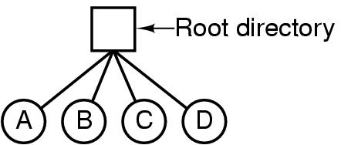
Single Level Directory Systems
The simplest form of directory system is having one directory containing all the files. Sometimes it is called the root directory.
The advantages of this scheme are its simplicity and the ability to locate files quickly
Used on simple embedded devices such as digital cameras and some portable music players.
A single-level directory system containing four files.
Tanenbaum, Modern Operating Systems 3 e, (c) 2008 Prentice-Hall, Inc. All rights reserved. 0-13-6006639

Slide 19
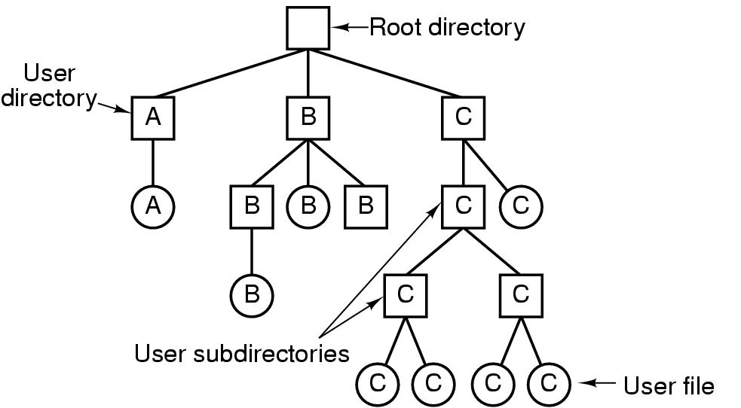
Hierarchical Directory Systems
A hierarchy (i.e., a tree of directories): provides a powerful structuring tool for users to organize their work. For this reason, nearly all modern file systems are organized in this manner.
Tanenbaum, Modern Operating Systems 3 e, (c) 2008 Prentice-Hall, Inc. All rights reserved. 0-13-6006639

Slide 20
Path names
Absolute /usr/carl/cs310/miderm/answers
Relative cs310/midterm/answers
. Refers to current (working) directory
.. Refers to parent of current directory
Tanenbaum, Modern Operating Systems 3 e, (c) 2008 Prentice-Hall, Inc. All rights reserved. 0-13-6006639

Slide 21
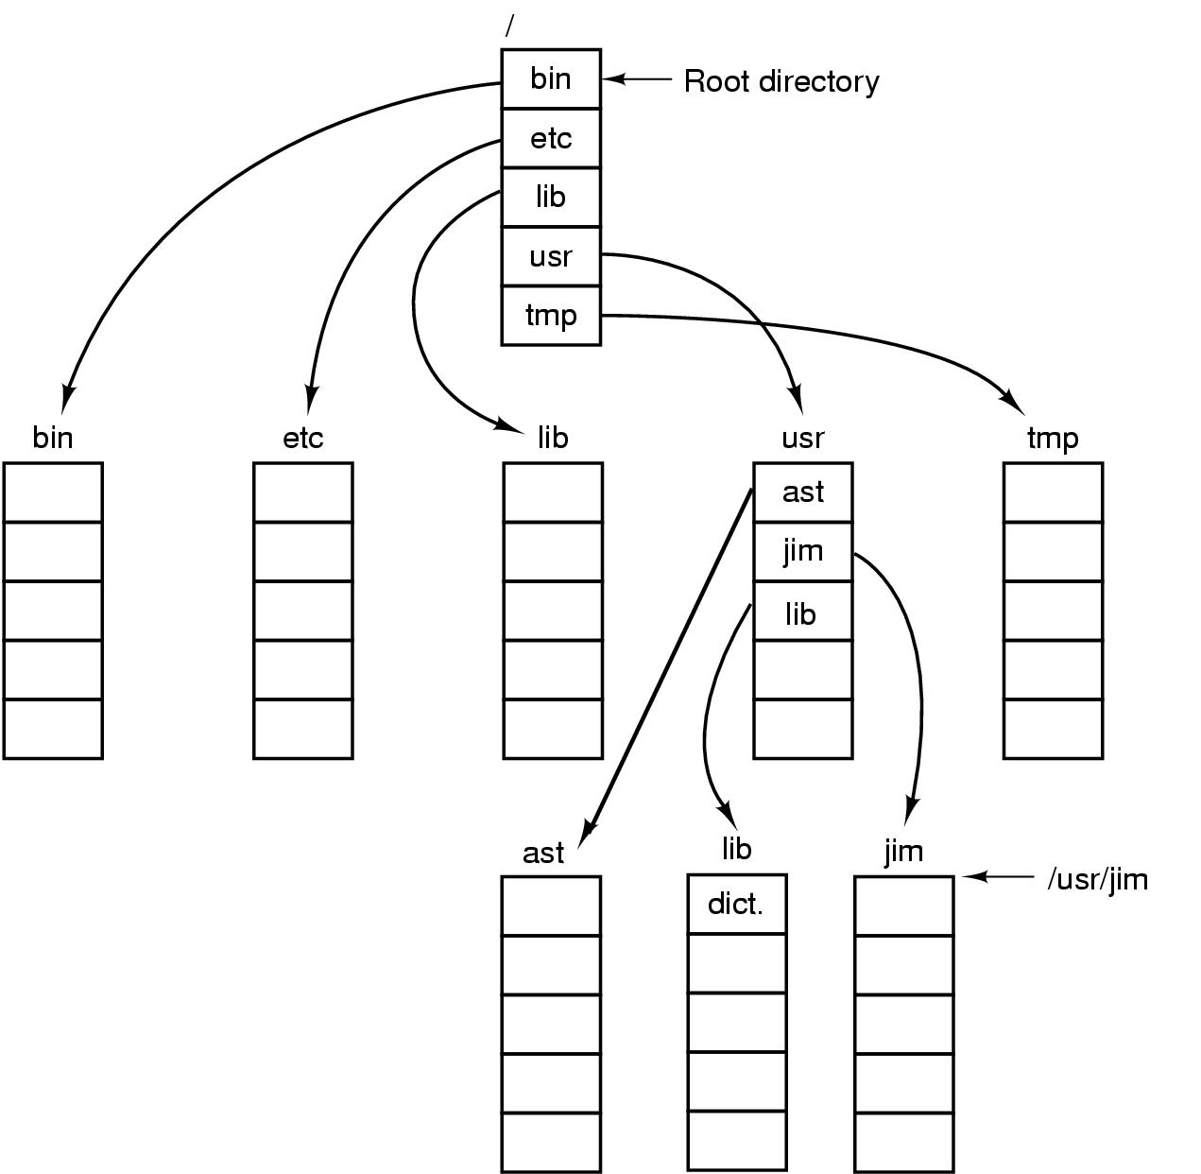
Path Names
A UNIX directory tree.
Tanenbaum, Modern Operating Systems 3 e, (c) 2008 Prentice-Hall, Inc. All rights reserved. 0-13-6006639

Slide 22
Unix cp commands involving dots
Cp ../lib/dictionary .
.. says go to parent (usr)
. says that target of the copy is current directory
cp /usr/lib/dictionary dictionary works
cp /usr/lib/dictionary /usr/ast/dictionary also works
Tanenbaum, Modern Operating Systems 3 e, (c) 2008 Prentice-Hall, Inc. All rights reserved. 0-13-6006639

Slide 23
Directory Operations
Create creates directory
Delete directory has to be empty to delete it
Opendir Must be done before any operations on directory
Closedir
Readdir returns next entry in open directory
Rename
Link Linking is a technique that allows a file to appear in more than one directory
Unlink Gets rid of directory entry
Tanenbaum, Modern Operating Systems 3 e, (c) 2008 Prentice-Hall, Inc. All rights reserved. 0-13-6006639

Slide 24
Allocating Blocks to files
Most important implementation issue
Methods
  Contiguous allocation
  Linked list allocation
  Linked list using table
  I-nodes
Tanenbaum, Modern Operating Systems 3 e, (c) 2008 Prentice-Hall, Inc. All rights reserved. 0-13-6006639

Slide 25

Contiguous Allocation
The simplest allocation scheme is to store each file as a contiguous run of disk blocks.
(a) Contiguous allocation of disk space for 7 files.
(b) The state of the disk after files D and F have been removed.
Tanenbaum, Modern Operating Systems 3 e, (c) 2008 Prentice-Hall, Inc. All rights reserved. 0-13-6006639

Slide 26
Contiguous Allocation
The simplest allocation scheme is to store each file as a contiguous run of disk blocks. Thus on a disk with 1-KB blocks, a 50-KB file would be allocated 50 consecutive blocks. With 2-KB blocks, it would be allocated 25 consecutive blocks.
In the figure, a total of seven files are shown, each one starting at the block following the end of the previous one.
Advantages
Easy to implement
Read performance is great. Only need one seek to locate the first block in the file. The rest is easy.
Disadvantages:
Disk becomes fragmented over time: Initially, this fragmentation is not a problem, since each new file can be written at the end of disk, following the previous one. However, eventually the disk will fill up and it will become necessary to either compact the disk, which is prohibitively expensive, or to reuse the free space in the holes. Reusing the space requires maintaining a list of holes, which is doable. However, when a new file is to be created, it is necessary to know its final size in order to choose a hole of the correct size to place it in (in order to create a word document the first thing the program asks is how many bytes the final document will be)
Uses:
CD-ROMs use contiguous allocation because the file system size is known in advance

Slide 27

Linked List Allocation
The second method for storing files is to keep each one as a linked list of disk blocks. The first word of each block is used as a pointer to the next one. The rest of the block is for data.
Also, it is sufficient for the directory entry to merely store the disk address of the first block. The rest can be found starting there.

Slide 28
Linked Lists
Advantages
Gets rid of fragmentation
Disadvantages
Random access is slow. Need to chase pointers to get to a block (To get to block n, the operating system has to start at the beginning and read the n−1 blocks prior to it, one at a time)
Also, the amount of data storage in a block is no longer a power of two because the pointer takes up a few bytes. While not fatal, having a peculiar size is less efficient because many programs read and write in blocks whose size is a power of two. With the first few bytes of each block occupied by a pointer to the next block, reads of the full block size require acquiring and concatenating information from two disk blocks, which generates extra overhead due to the copying.
Tanenbaum, Modern Operating Systems 3 e, (c) 2008 Prentice-Hall, Inc. All rights reserved. 0-13-6006639

Slide 29
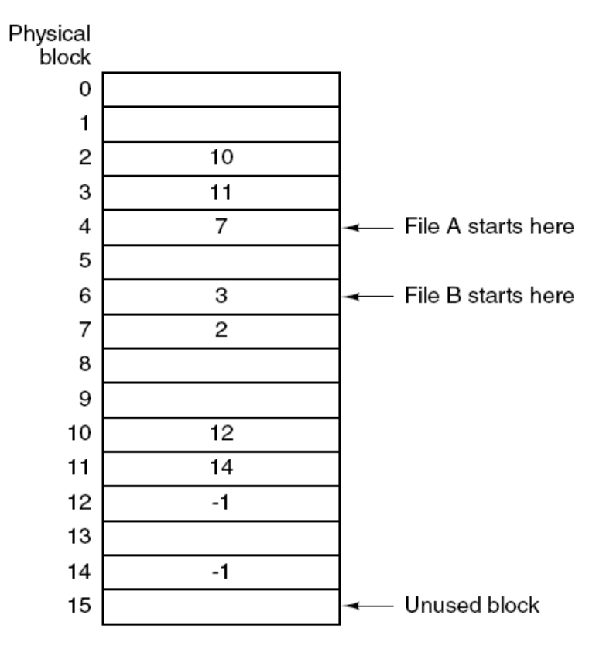
The Solution-Linked List Allocation Using a Table in Memory
Linked list allocation using a file allocation table in main memory.
Tanenbaum, Modern Operating Systems 3 e, (c) 2008 Prentice-Hall, Inc. All rights reserved. 0-13-6006639

Slide 30
Linked lists using a table in memory
Both disadvantages of the linked-list allocation can be eliminated by taking the pointer word from each disk block and putting it in a table in memory.
Put pointers in table in memory
Such a table in main memory is called a File Allocation Table (FAT)
File A uses disk blocks 4, 7, 2, 10, and 12, in that order, and file B uses disk blocks 6, 3, 11, and 14, in that order. Using the table of the following figure, we can start with block 4 and follow the chain all the way to the end. The same can be done starting with block 6. Both chains are terminated with a special marker (e.g.,−1) that is not a valid block number.
Fully supported by Windows
Tanenbaum, Modern Operating Systems 3 e, (c) 2008 Prentice-Hall, Inc. All rights reserved. 0-13-6006639

Slide 31
Linked lists using a table in memory
Advantages
The entire block is available for data.
Random access is much easier.
Disadvantages
The entire table must be in memory all the time to make it work. Table becomes really big E.g 200 GB disk with 1 KB blocks needs a 600 MB table. Growth of the table size is linear with the growth of the disk size
Tanenbaum, Modern Operating Systems 3 e, (c) 2008 Prentice-Hall, Inc. All rights reserved. 0-13-6006639

Slide 32
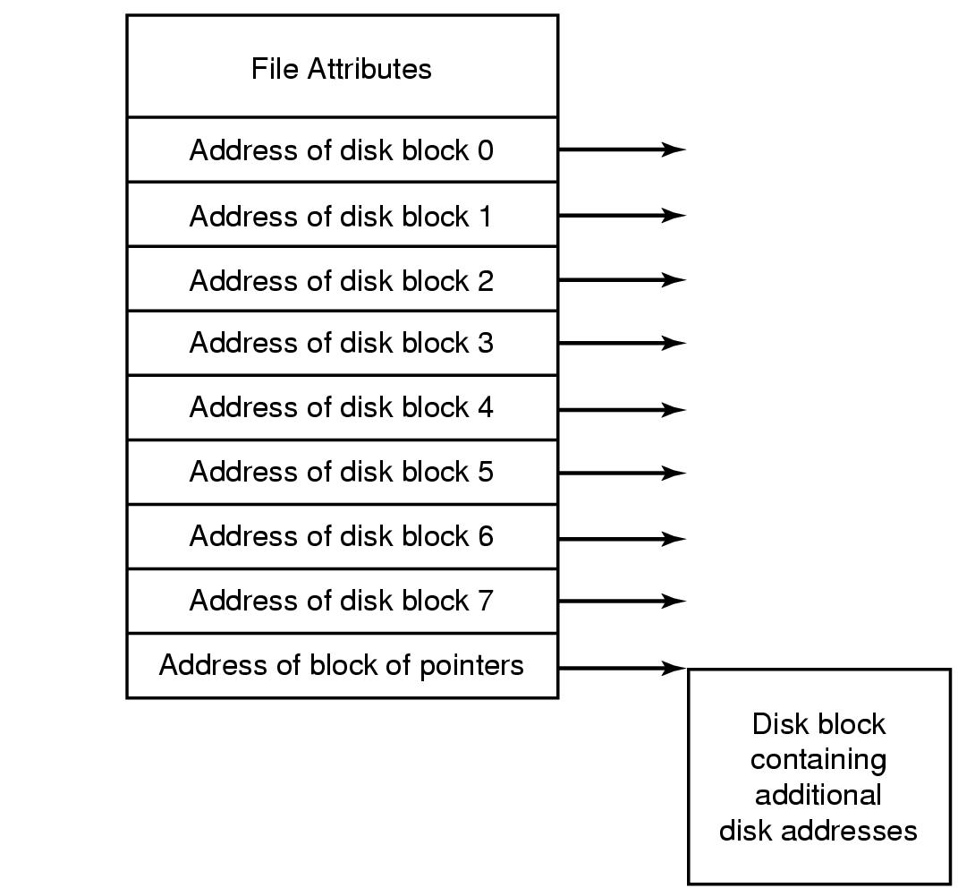
I-nodes
An example i-node.
Tanenbaum, Modern Operating Systems 3 e, (c) 2008 Prentice-Hall, Inc. All rights reserved. 0-13-6006639

Slide 33
I-nodes
Keeping track of which blocks belong to which file is to associate with each file a data structure called an i-node (index-node), which lists the attributes and disk addresses of the file’s blocks.
The big advantage of this scheme over linked files using an in-memory table is that the i-node need be in memory only when the corresponding file is open.
K active files, N blocks per file => k*n blocks max!!
Solves the growth problem
Tanenbaum, Modern Operating Systems 3 e, (c) 2008 Prentice-Hall, Inc. All rights reserved. 0-13-6006639

Slide 34
I-nodes
One problem with i-nodes is that if each one has room for a fixed number of disk addresses, what happens when a file grows beyond this limit?
One solution is to reserve the last disk address not for a data block, but instead for the address of a block containing more disk-block addresses.
Tanenbaum, Modern Operating Systems 3 e, (c) 2008 Prentice-Hall, Inc. All rights reserved. 0-13-6006639

